Slide 1
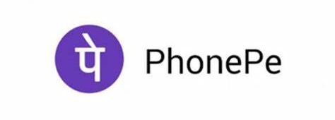
Business Analyst Internship at PhonePe
Niyati Jain
CSE-D VIII Sem
189301051
Under the guidance of Dr. Shiladitya Bhattacharjee

Slide 2
Agenda
01. Introduction
02. Motivation
Introducing Problem statement and brief description
Stating the requirement of our project.
03. Methodology
04. Timeline
05. Conclusion
The workflow and chronology of methods are explained.
The timeline of the project is stated with deadlines and Gantt Chart
A concise conclusion along with scope for future works..

Slide 3

Problem Statement
My responsibility with regards to my position as an Analyst at PhonePe includes handling the Data-flow, Information Retrieval, Dashboards and Coordinating with Stakeholders requirements regarding the Health Insurance Products on PhonePe.

Slide 4
Introduction
I will be serving this major project period by gaining industry experience in PhonePe as an analyst intern. The 6-months internship period consists of 1-month of training followed by 5-months of execution that is in line with the job requirement.
After emerging as one of India’s leading digital payments facilitators over the last two years, PhonePe is now attempting to come up as a full-stack financial services player. PhonePe forayed into financial services with the launch of digital gold, providing users with a safe and convenient option to buy 24-karat gold securely on its platform. PhonePe has since launched Mutual Funds and Insurance in four categories namely: Life, Health, Motor and General Insurance. The Health insurance category particularly has four products: Aarogya Sanjeevani, Simple Health, COVID-19 and Super Top-Up.

Slide 5
About the Company
PhonePe is an Indian digital payments and financial technology company headquartered in Bengaluru, Karnataka, India. It is India’s leading UPI fin-tech Start-up with over 280 million registered users. PhonePe was founded in December 2015, by Sameer Nigam, Rahul Chari and Burzin Engineer. The company allows users to send and receive money, recharge mobile, DTH, data cards, pay at stores, make utility payments, buy gold, and make investments. PhonePe is accepted at over 18 million merchant outlets across 500 cities nationally.
PhonePe went live for customers in August 2016 and was the first non-banking UPI app and offered money transfer to individuals and merchants, recharges and bill payments to begin with. In 2017, PhonePe forayed into financial services with the launch of digital gold, providing users with a safe and convenient option to buy 24-karat gold securely on its platform. PhonePe has since launched Mutual Funds and Insurance products like tax-saving funds, liquid funds, international travel insurance, Corona Care, a dedicated insurance product for the COVID-19 pandemic among others. PhonePe launched its Switch platform in 2018, and today its customers can place orders on over 300 apps including Ola, Myntra, IRCTC, Goibibo, RedBus, Oyo etc. directly from within the PhonePe mobile app.

Slide 6
Motivation
At PhonePe, one gets to build for India’s next billion users, which gives a sense of responsibility.
It is a fast-paced Startup which helps build upon existing skill sets, gain experiences in many functional areas, and take on a ton of real tasks. As the company grows quickly, so does opportunities for career advancement.
Working with the best minds in the industry enables me to learn a lot. Phonepe’s diverse and inclusive corporate culture allows me to showcase as well as hone my existing skills and get better every day.
This Internship really helps boost one’s credentials as they offer professional training modules/courses, expert guidance, and a great working environment throughout the commitment period. The impeccably curated training program helps early onboarding of a fresher candidate and prepares him/her to efficiently find their place and pace the corporate ladder. After serving the limited tenure of the internship period, the company also entitles you to achieving a project and an internship certificate.

Slide 7
Methodology
I perform the following job roles as in charge of analytics concerning PhonePe’s Health Insurance products:
Data Retrieval
Data Analysis and Visualization
Data Cleaning and Maintenance
Collaborating with Stakeholders

Slide 8
Data Retrieval
To undergo the task of Data extraction, I use SQL to retrieve data from various databases. The real-time data is stored in Foxtrot and other relevant information can be found in the database warehouse (Lucy). I write my SQL queries on Zeppelin notebooks and extract, feed or work with useful data available in these stored databases.

Slide 9
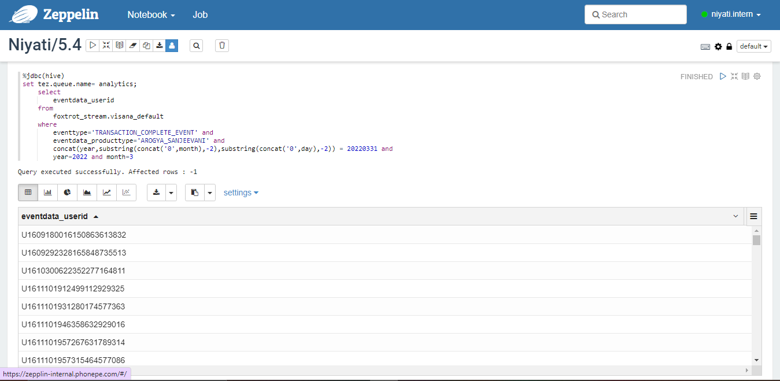
SQL Query on Zeppelin

Slide 10
Data Analysis and Visualisation
This part requires me to analyse data by systematically applying statistical and/or logical techniques to describe and illustrate, condense and recap, and evaluate it.
Phonepe has taught us to use various analytical tools and software to perform different analysis and visualization tasks. We use comprehensive software called QlikView and QlikSense to visually represent data in Graphs and maintain dashboards. Along with this, the software aid us in publishing auto-generated email reports and dashboards that are scheduled to published automatically daily through the realtime ingested data through NPrinting. We also use MS-Excel to represent small-scale analysis and manipulations.

Slide 11
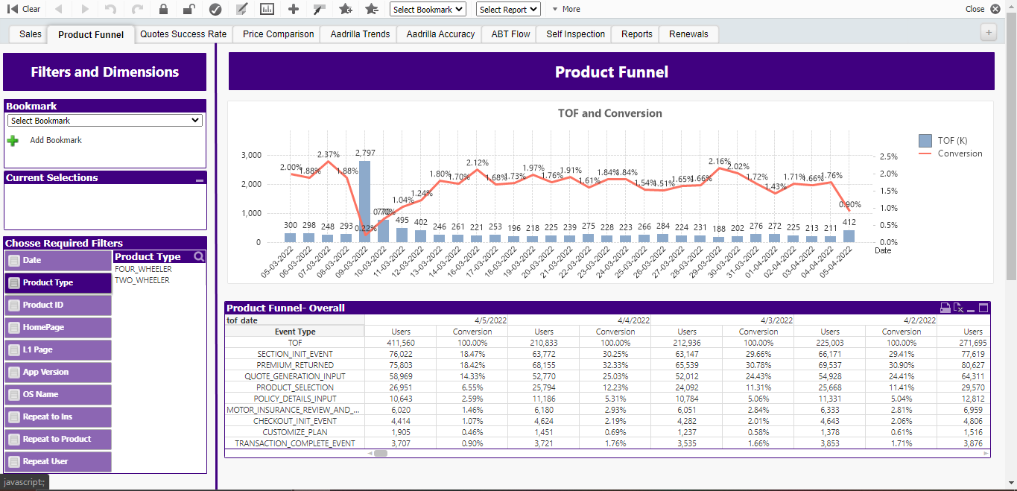

Slide 12
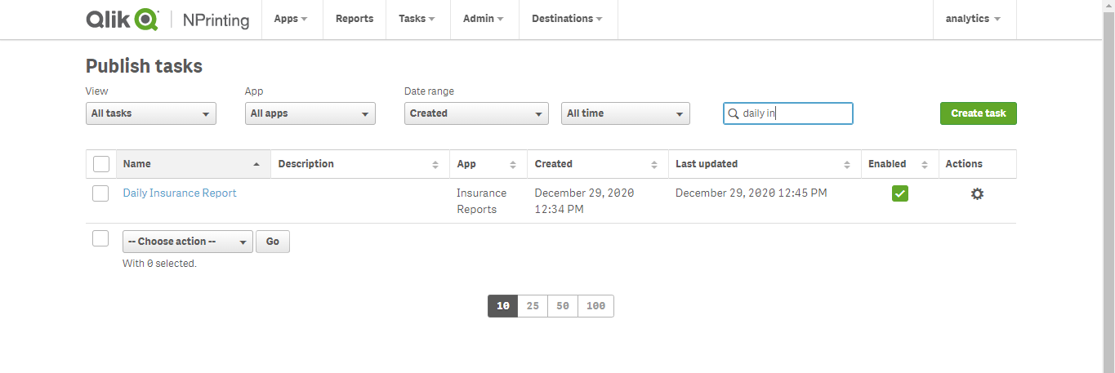
NPrinting

Slide 13
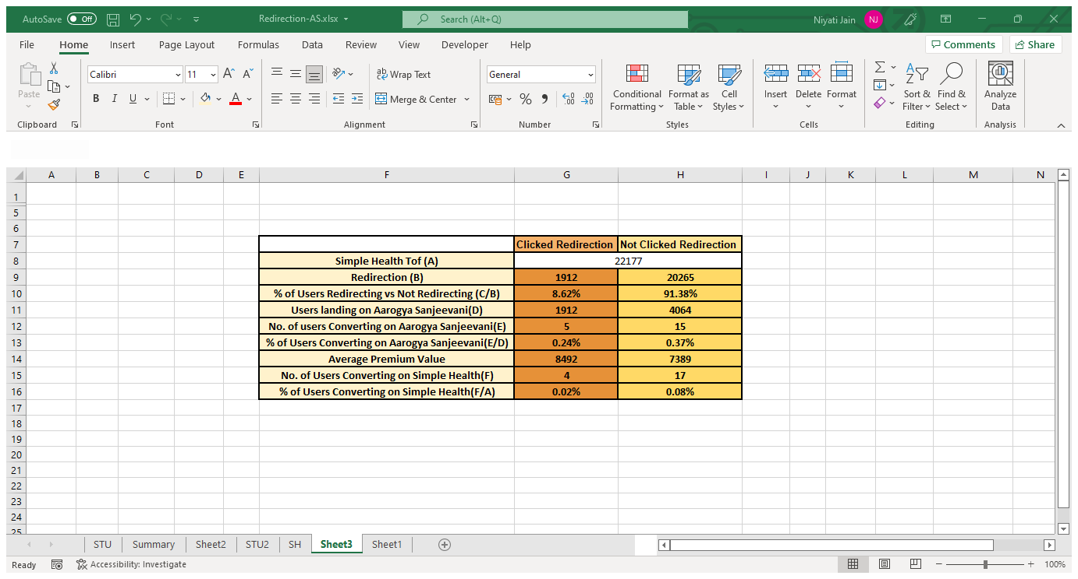

Slide 14
Data Cleaning and Maintenance
Another essential job responsibility includes cleaning raw datasets (Removing Duplicates, Fix structural errors, Handle missing data, Filter unwanted outliers, etc.) and transforming data i.e. converting data from one format or structure into another. Along with this, I make sure all the necessary data is ingested in Lucy and coordinate with the IT team to understand the data stored to fulfil the necessary tasks analysis.

Slide 15
Collaborating with Stakeholders
One major aspect of my role as an Analyst at PhonePe is to single-handedly deal with the Health Insurance stakeholders to fulfil their asks/updates on relevant data or insights that will help them take judicious product management decisions. I regularly stay connected with them to provide them useful information/highlights after thorough analysis as well as cater to their requirements that circles around User Profiling and Product Usage.

Slide 16
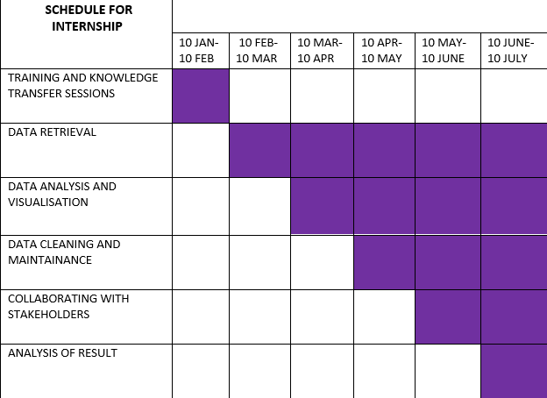
Gantt Chart

Slide 17
Conclusion
It has been an enriching experience so far where I got acquainted with and now well-versed with so many different tools and software that are required for Data Analysis. I can extract, handle and customize any type of data and convert it into valuable information. It has added accolades to my resume owing to its global reputation and reach. This internship has helped me gain experiences, knowledge as well as the confidence to enter the corporate world with full swing.

